Slide 1
MongoDB ---Relations
--GOVARDHAN R S

Slide 2
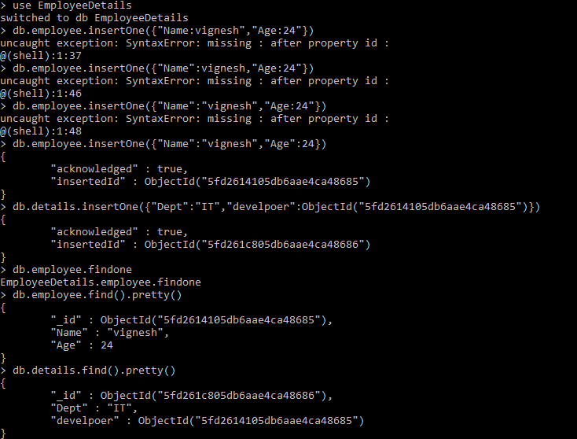
One to one

Slide 3
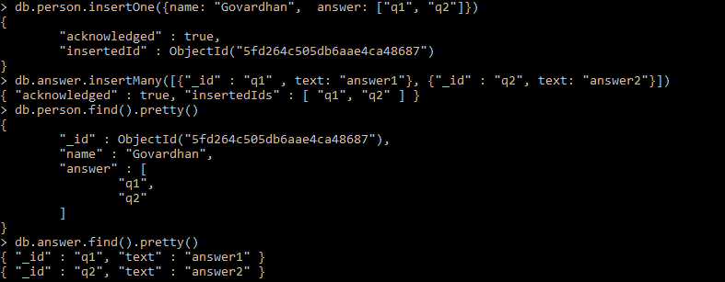
One to many

Slide 4
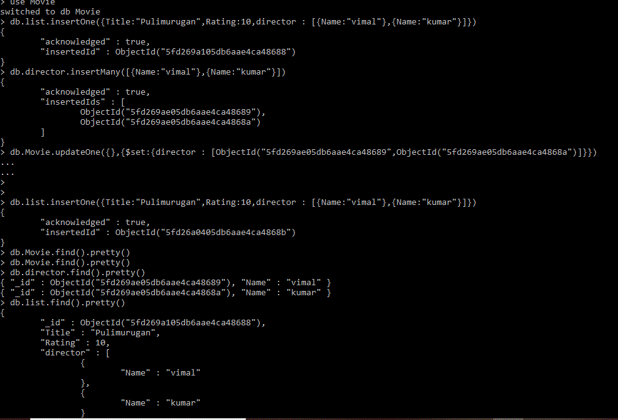
Many to many

Slide 5
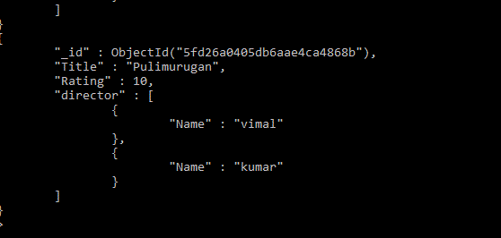

Slide 6

lookup

Slide 7
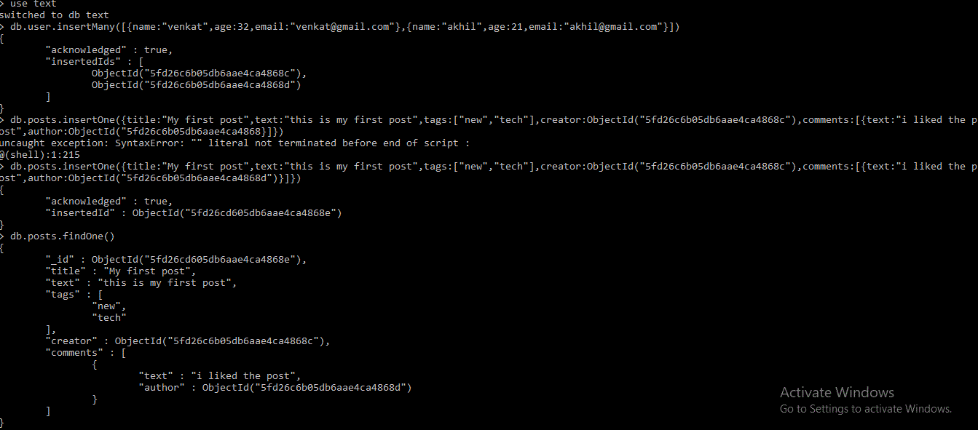
Blog

Slide 8
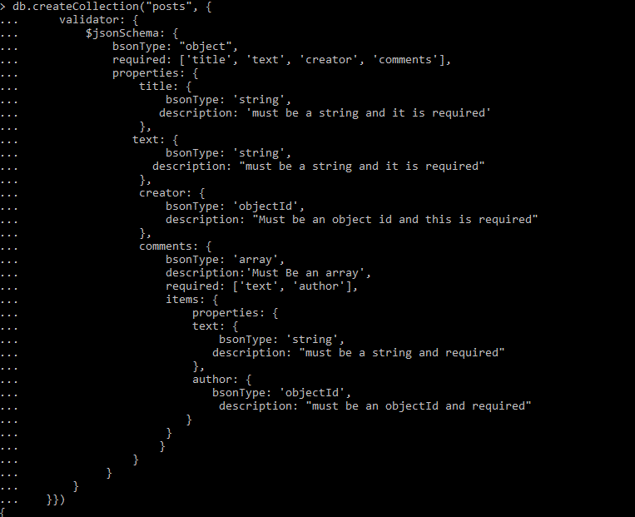
Validator

